Slide 1
Resisting informal settlement upgrading after a fire: contending forms of governance in Cape Town
Laurence Piper, Political Studies, University of the Western Cape, Cape Town, South Africa
lpiper@uwc.ac.za
City Futures 2019, Dublin, 20-21 June 2019

Slide 2
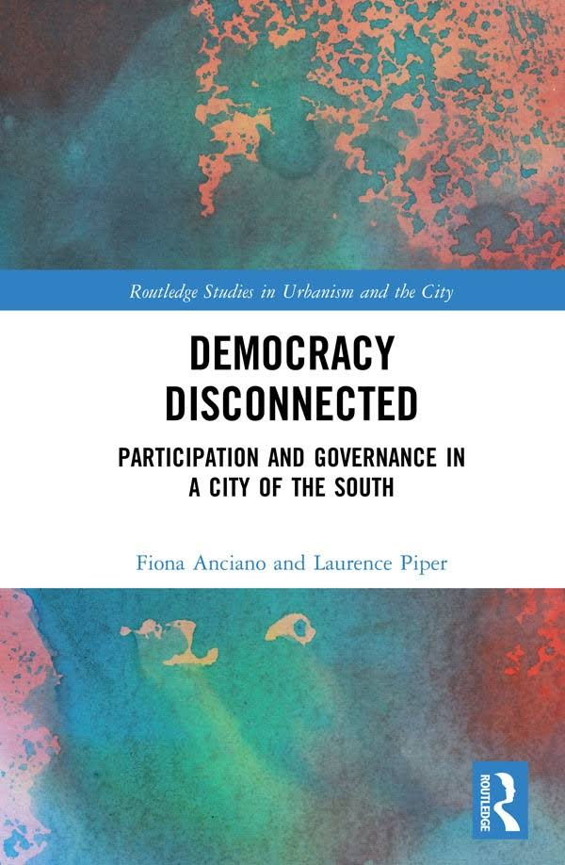
Based on Chapter Six in Anciano & Piper. 2019. Democracy Disconnected. Routledge.
Available from
Routledgebooks http://goo.gl/WpNh68
Amazon:
http://goo.gl/5zmLHt
See also http://democracydisconnected.com/

Slide 3
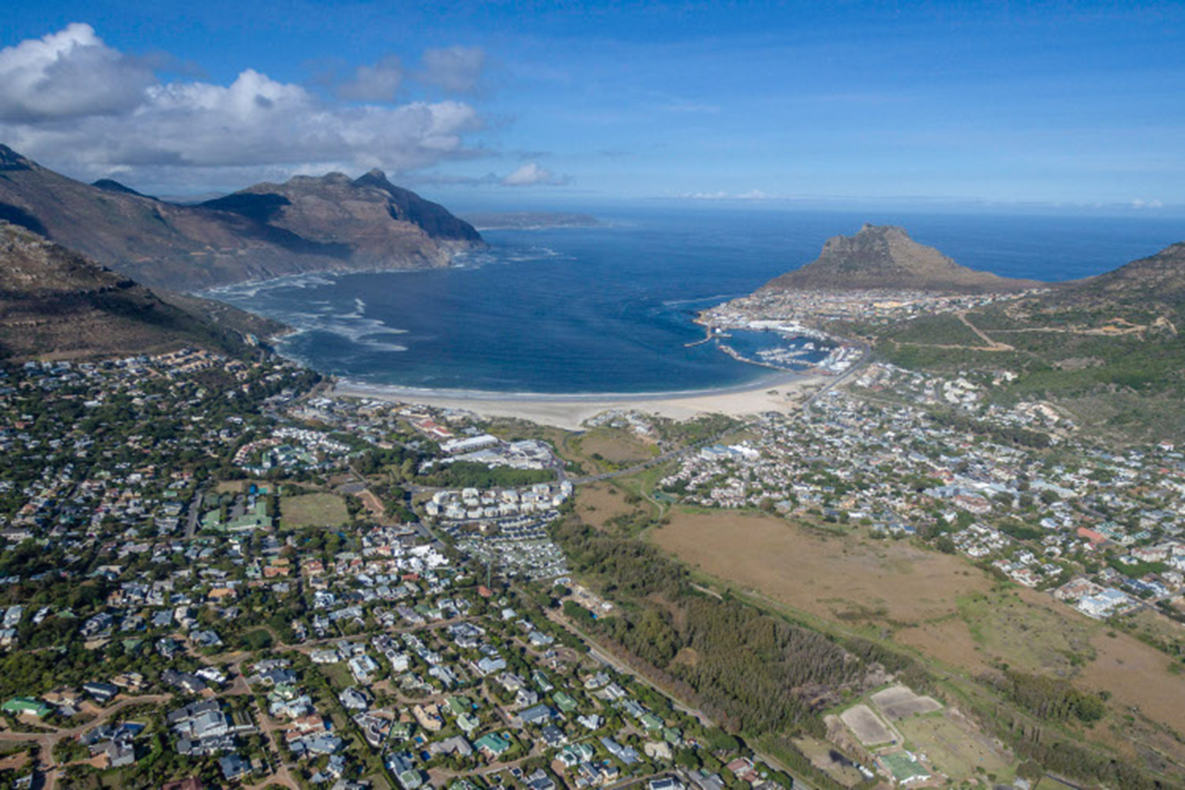
Hout Bay, Cape Town, South Africa

Slide 4
Three settlements of Hout Bay: the Valley, Hangberg & Imizamo Yethu

Slide 5
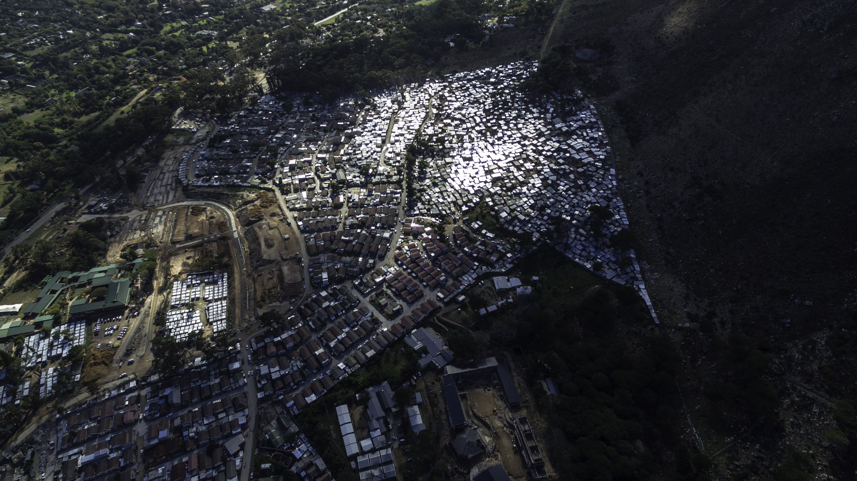
Imizamo Yethu
42hectares 15000-20000 people

Slide 6
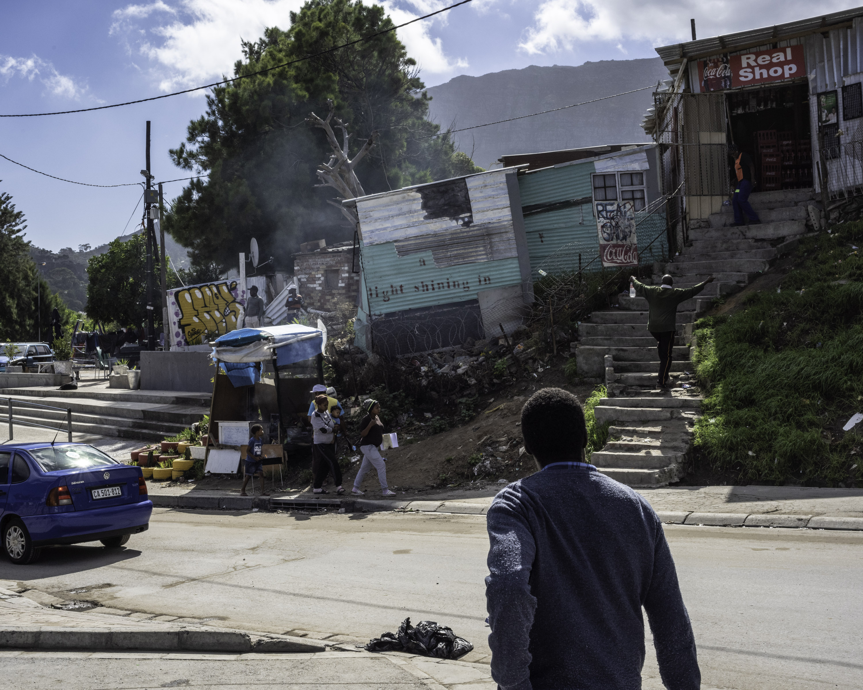
Poor, black settlement, mix of formal and informal housing

Slide 7
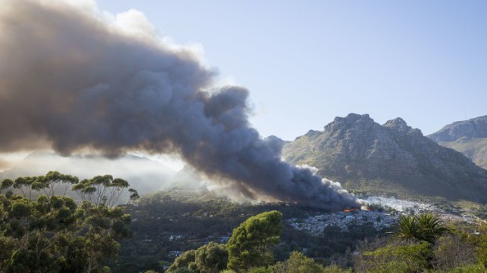
Massive fire April 2017.
2000 homes & 10,000 people

Slide 8
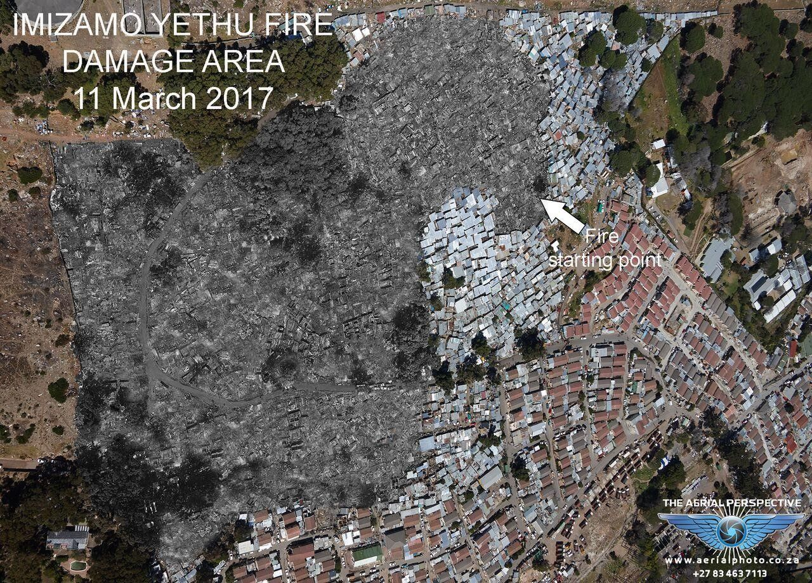
Fire damage March 2017

Slide 9
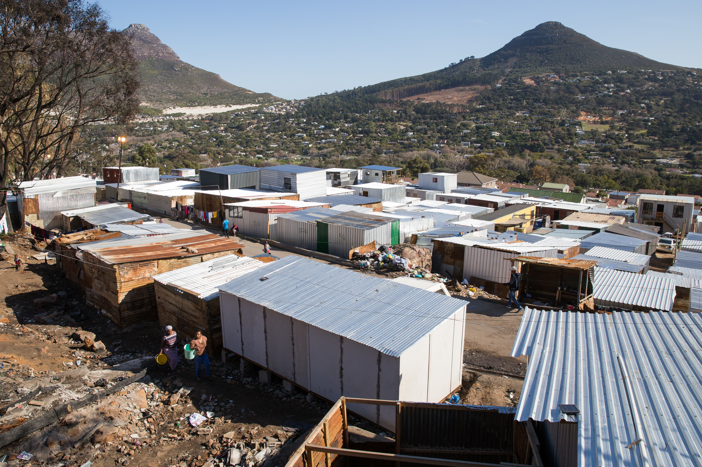
Yet resistance to ‘super-blocking’ (upgrading after the fire)

Slide 10
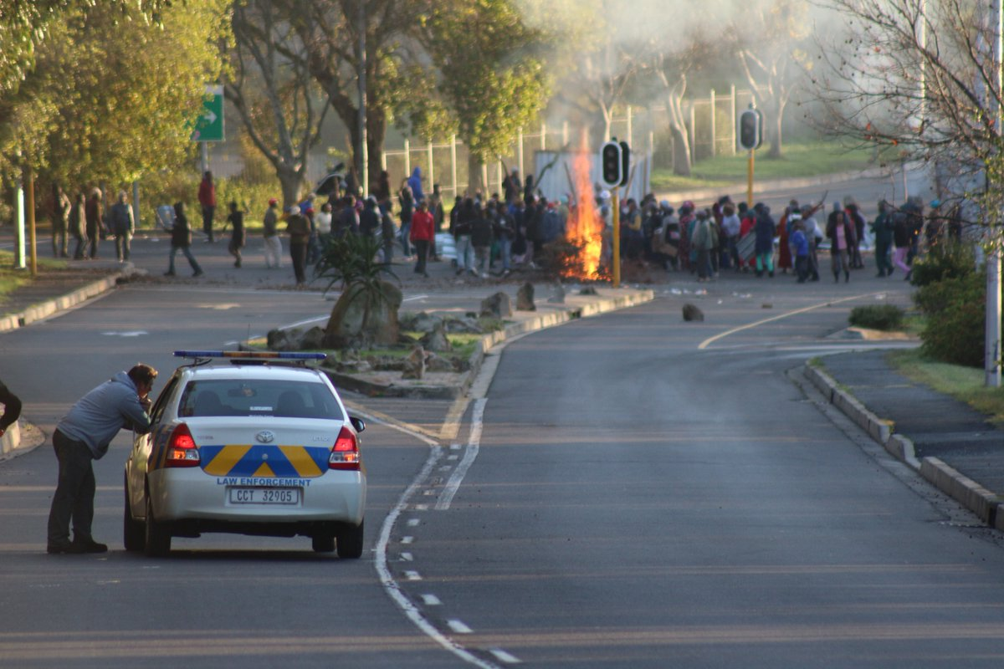

Slide 11
Explaining resistance to upgrading
Distrust of state and fear of displacement but also defence of informality under threat by upgrading.
Need to understand the multiple and contending forms of
  Public authority, and
  Governance
That govern daily life in Imizamo Yethu (and Hout Bay), especially around meeting key needs of urban life
  Livelihoods, housing, transport, security etc.
The inability of formal systems to adequately meet these needs (social/spatial justice?) forms the basis of politics in urban South
Two theoretical moves re governance: power and the city
  (i) the conception of power as social production, and
  (ii) the de-territorialisation of the production of the city

Slide 12
(i) Power and the city: from control to construction
Understanding urban governance is assisted by an alternative conception of power
Move from power as control over people: e.g. Foucault, sovereign + disciplinary + biopolitics.
To power as social production of the city: Clarence Stone on local government + business and regime theory
Social production as both the built environment and the systems that go with it (electricity, water, transport, retail, etc).

Slide 13
(ii) The de-territorialisation of social production of the urban south
Beyond Stone’s notion of governance by regimes between City Hall and local business – beyond & below the local
(i) international capital
(ii) state (multi-level governance)
  National
  Provincial
  Local
(iii) local residents
  co-governance and contention below the local state by middle-class and poor settlements
    nodal governance
    Informal governance by gangs, vigilantes etc

Slide 14
Multiple public authorities and the response to the Imizamo Yethu fire
Responding to the fire
  Three spheres of the RSA state initially involved
Rebuilding
  City Hall, contractors & super-blocking
Resistance
  Attacks on ANC leaders by sections from burned area, houses burned
Re-organising
  City, local leaders, mediators, new vigilante formations

Slide 15
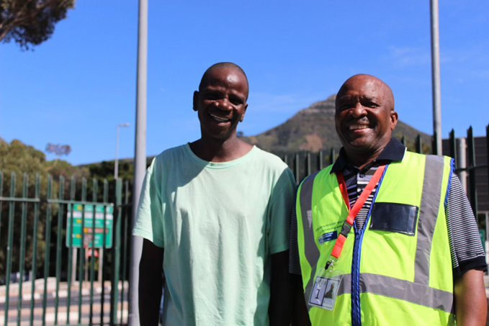

Slide 16
Multiple forms of governance
Not just rulers (public authorities) but also about rules (governance)
Informal housing & informal livelihoods
  Shebeens
  Rentals
Formalisation through super-blocking as uniform provision of shelter (meeting needs of poor and marginalised for their wellbeing)
A clash between logics of developmental and informal governance
  Plots too small and architecture inappropriate for both activities

Slide 17
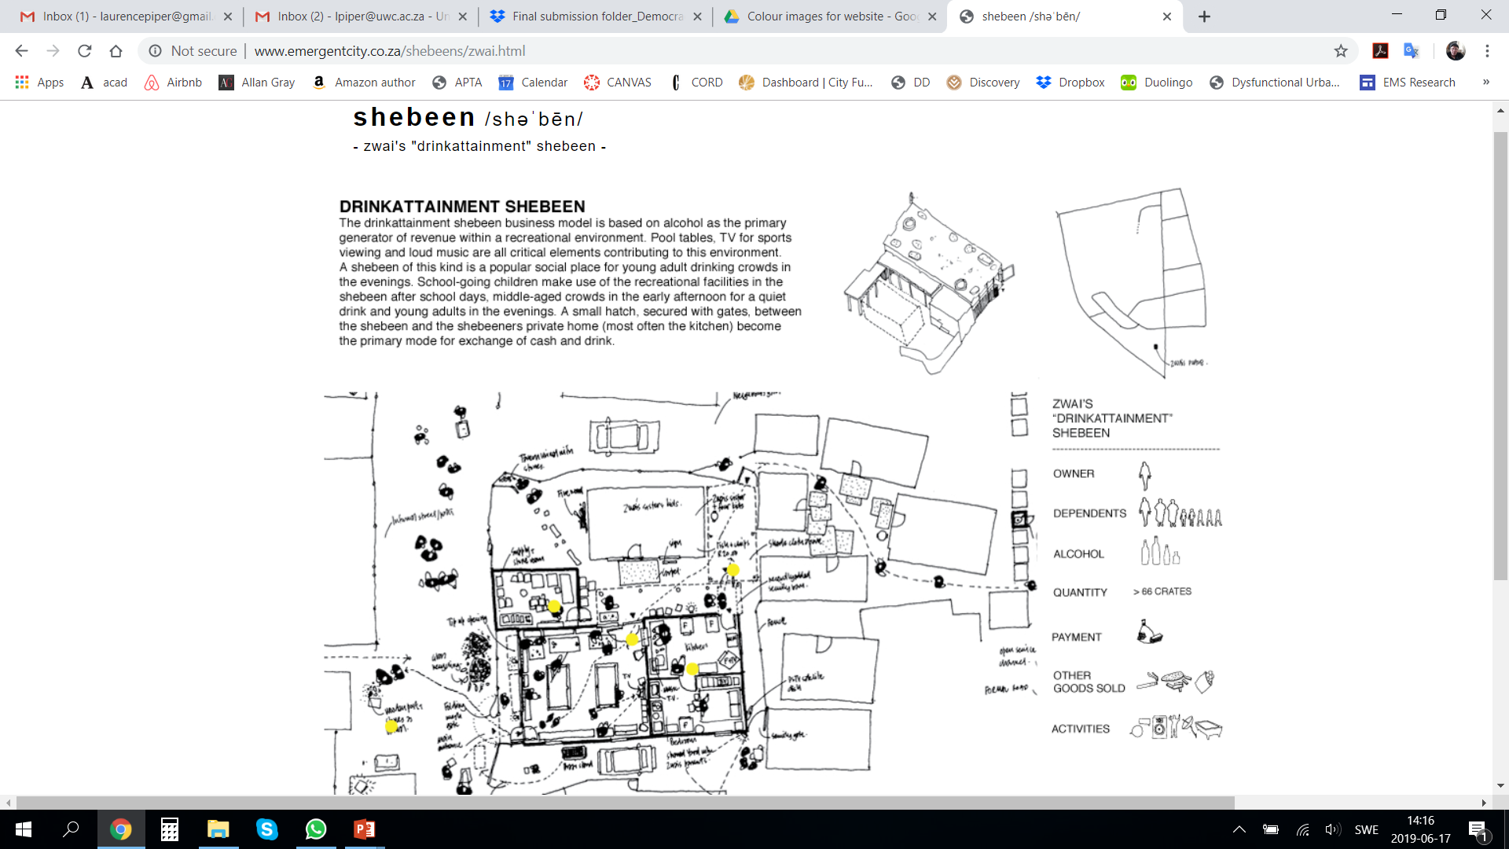

Slide 18
POTUS: Politics of the Urban South
Politics of the Urban South takes place in context of:
1. Multiple formal and informal, state and non-state, public authorities
  E.g. City Hall, Oceana fish company, HBRRA, patrollers
2. Multiple and contending forms of governance
  These vary by issue and place
  E.g. Developmental, Informal, Bureaucratic, Market, Nodal
3. Reflects the de-territorialisation of productive power to make the city in urban South

Slide 19
Participation, scale and the just city
For the city of the urban south, constructing a just city requires
1. understanding the multiple and contending authorities & forms of governance that characterise POTUS in a PLACE, including informal kinds.
2. implies a requirement for NEW forms of representation, participation and policy-making process, and BELOW the current scale of formal systems.
Justice requires governance innovation at a new scale: where informality is common, building a just city requires building the capacity for democratic innovation at the level of the settlement/neighbourhood.

