Slide 1

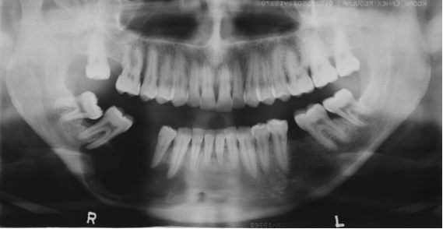
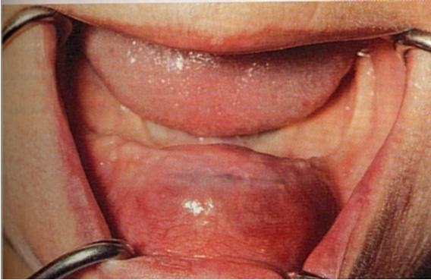
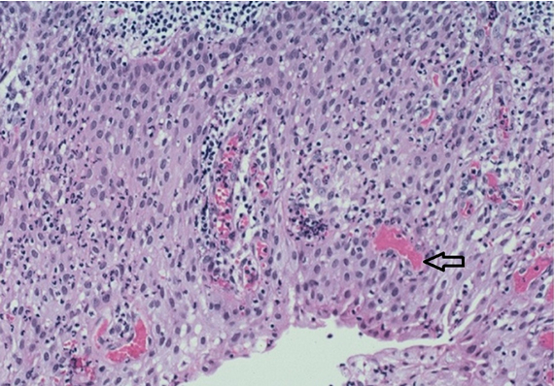
Management of residual cysts of the jaws:
an analysis of a large case series
Titinchi F, Morkel JA
Department of Maxillo-Facial & Oral Surgery, University of the Western Cape, Cape Town, South Africa. (ftitinchi@uwc.ac.za)
Introduction
Figure 3: Pantomograph showing an atypical residual cyst in the right mandible with thinning of inferior cortex that mimics a tumour.
Residual cysts are infrequent inflammatory cysts of the jaws which are of odontogenic origin. They are usually preceded by a radicular cyst which has developed apical to a carious tooth. These cysts usually present with similar features as radicular cysts; however, due to absence of the causative tooth, they can mimic more aggressive cysts and tumours on radiographs (Figure 3). Moreover, they have the ability to destroy bone within the jaws without any symptoms [1].
The aim of this study was to describe the clinico-pathological features of residual cysts in order to discern them from other cystic lesions as well as analyse their management and recurrence patterns.
Methods
A surgical management protocol was formulated based on the findings of this study (Table 1). Enucleation of the entire cyst lining was found to be appropriate for most residual cysts as the majority of lesions were less than 40mm in diameter. One extensive lesion measuring 125mm in diameter underwent marsupialization to reduce its size initially. Resection with reconstruction was utilized for residual cysts that developed primary intraosseous odontogenic carcinoma.
Sixty-four histopathologically confirmed residual cysts presenting at Tygerberg Hospital over a period of 30 years were retrospectively analysed. Data extraction included the patient’s age and gender as well as the presenting signs and symptoms. The detailed location of the lesion within the jaws was noted. Histopathological features were recorded including any cases that developed into squamous cell carcinoma. Management and follow-up was also noted.
Data were analysed using student’s t-test and chi-square test to draw correlations between
various parameters such as lesion size, gender, locularity, radio-density etc. Epi Info V7 software was used to perform statistical analysis. Statistical significance was set at P < 0.05.
Table 1: Surgical protocol for the management of residual cysts.
Method | Clinico-pathological features
Enucleation/curettage | - Size of lesion less than 4 cm on pantomograph
 | - Easily accessible anatomical location
 | - Unilocular lesions
Decompression followed by enucleation | - Size of lesion greater than 4 cm on pantomograph
 | - Difficult to access regions (e.g. posterior maxilla)
 | - Unilocular or multilocular lesions
 | - Thinning of mandibular cortex with risk for pathological fracture
Resection & Reconstruction | - Presence of malignant transformation (primary intraosseous squamous cell carcinoma)
 | - Extension/invasion of adjacent soft tissues
Results
Most lesions presented in patients above 50 years of age (46.8%) and were edentulous (60.9%) (Figure 1). This was significantly different when compared to lesions in dentate patients (P<0.01). Mandibular posterior region (51.6%) was the most commonly involved site.
Clinicopathological features that aided in the diagnosis included long-standing history with
slow growing swelling and presence of well-defined, unilocular cystic lesion associated with previously extracted dentition.
Discussion
Residual cysts are surgically managed by enucleation, marsupialization or decompression to decrease the intraluminal pressure within the cyst [2]. Smaller lesions can be enucleated entirely at the time of biopsy and is the ideal treatment choice. Enucleation was shown to be an acceptable method in this sample with low morbidity and recurrence rate. However, there are some contra-indications to enucleation which include large lesions, difficult accessibility, proximity to vital structures, and patient’s age [3].
Primary intraosseous odontogenic carcinoma is a squamous cell carcinoma originating within the jaws without primary communication with the oral cavity and arises primarily from rests of odontogenic epithelium [4]. It is a sporadic malignant neoplasm and presents almost entirely in the jaws. The estimated frequency of primary intraosseous odontogenic carcinoma has been reported to be 1–2% of all oral cancer. It has predilection for older males and involves mostly the mandible [4]. Although both cases in this sample occurred in the mandible, one patient was a middle aged female which did not fit the profile of patients affected by this devastating lesion.
Figure 1: Extensive swelling in the anterior mandible caused by residual cyst as well as histological finding of hyaline bodies (arrow).
Enucleation was a successful method in the management of residual cysts with very low recurrence rate (1.6%). Adverse outcomes included two patients (3.1%) that developed squamous cell carcinoma (SCC) from the cyst lining. Osteolytic character of the SCC is depicted in Figure 2. One patient suffered a pathological mandible fracture immediately post enucleation (Figure 3).
Conclusion
Residual cysts should be high on the list of differential diagnosis when elderly, edentulous patients present with cystic lesions in the jaws. All lesions should undergo histopathological examination along with radiological correlation as the cyst lining has the potential to transform into primary intra-osseous squamous cell carcinoma with devastating consequences.
References
Titinchi F, Morkel J. Residual cyst of the jaws: A clinico-pathologic study of this seemingly inconspicuous lesion. PLoS One. 2020 Dec 17;15(12):e0244250.
Allon DM, Allon I, Anavi Y, Kaplan I, Chaushu G. Decompression as a treatment of odontogenic cystic lesions in children. J Oral Maxillofac Surg. 2015; 73: 649–654. https://doi.org/10.1016/j.joms.2014.10.024
Torul D, Bereket MC,O¨ zkan E. Management of Large Residual Cyst in Elderly Patient with Decompression Alone: Case Report. Balk J Dent Med. 2018; 22: 171–174.
Bodner L, Manor E, Shear M, van der Waal I. Primary intraosseous squamous cell carcinoma arising in an odontogenic cyst: a clinicopathologic analysis of 116 reported cases. J Oral Pathol Med. 2011; 40: 733–738.
Conflict of interest: None. Ethics: granted from UWC BMREC.
Figure 2: Squamous cell carcinoma arising from the lining of residual cyst in the mandible

