Slide 1




Galaxy 2018, Capetown
3rd – 5th April 2018
Community building-Lessons from The Carpentries
Presented by CF AJILOGBA, PhD
Department of Microbiology
Microbial biotechnology group
North-West University, Mafikeng campus
South Africa

Slide 2
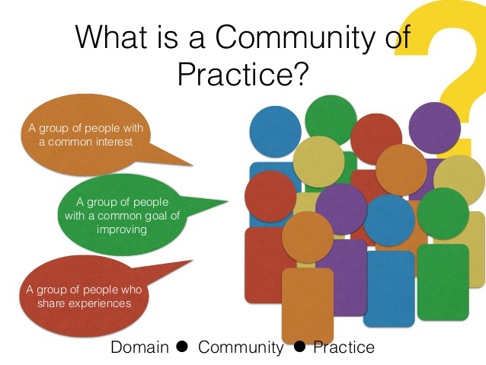
What is community building
Communities of practice are groups of like-minded, interacting people who filter, analyze, invest and provide, convene, build, and learn and facilitate to ensure more effective creation and sharing of knowledge in their domain.

Slide 3
Objectives of Communities of Practice
Communities of practice identify, create, store, share, and use knowledge
They enable professional development
They reduce rework and prevent reinvention of the wheel
They permit faster problem solving and response time to needs and inquiries
They illuminate good practice
They spawn new ideas for products and services
They enable accelerated learning
They connect learning to action
They make for organizational performance improvement

Slide 4
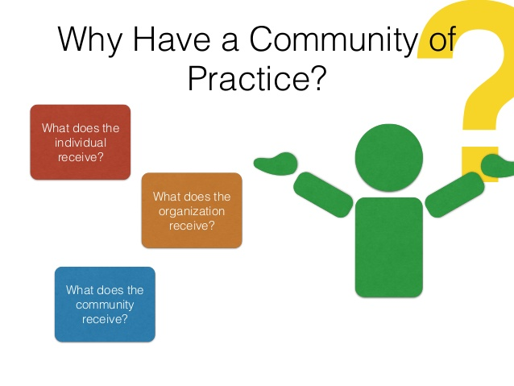
What Do Communities of Practice Do?
Communities of practice provide a means to exchange data, information, and knowledge freely
They break down communication barriers
They provide an informal, welcoming social environment
They provide a means for relationship-building and networking
They populate and reference their knowledge network workspace

Slide 5
How Do Communities of Practice Operate?
After a workshop like this, volunteers who would like to follow up with this lesson could come together to discuss on way forward with use of Galaxy in their Dept, Lab, or group
Is it relevant to what we are doing? Y/N
Is one of us very good with it or better than the others? Y/N
Do we need to be taught again? Y/N
If all these questions are yes or the first and last question answer is yes, then having a community, like a study group is one of the best option
Note
One key thing that makes a project sustainable is the desire for continuity

Slide 6

Getting set up

Slide 7
Set up the website
You can use the template from the carpentries or the template from mozzilla group or come up with your own template
The website should have all the details about what the group intends to do,
What materials or software they would use to carryout the study,
The necessary links to sample data to use in the course of the study and/or
The link on how to use Galaxy as the case maybe
The link to an etherpad or interactive document in the course of the group meeting
The contact name, email and phone number of the volunteer hosting the group

Slide 8
Sample of NWU R STUDY GROUP WEBSITE
https://rstudygroup.wordpress.com/

Slide 9
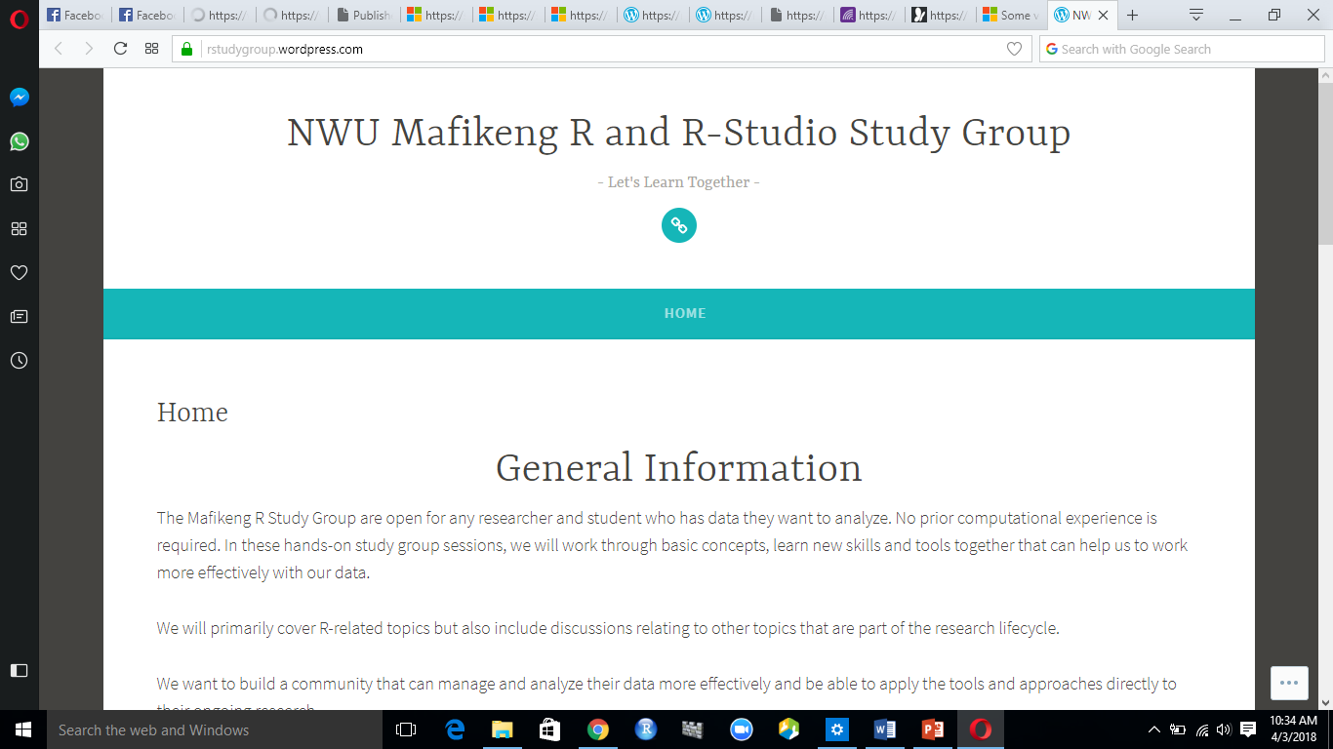

Slide 10
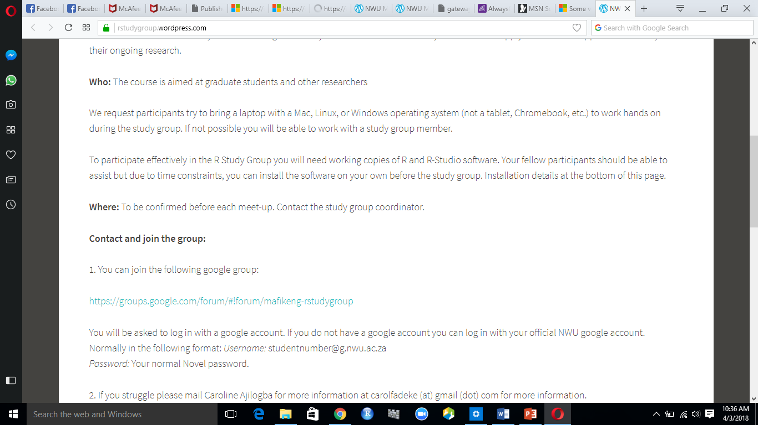

Slide 11
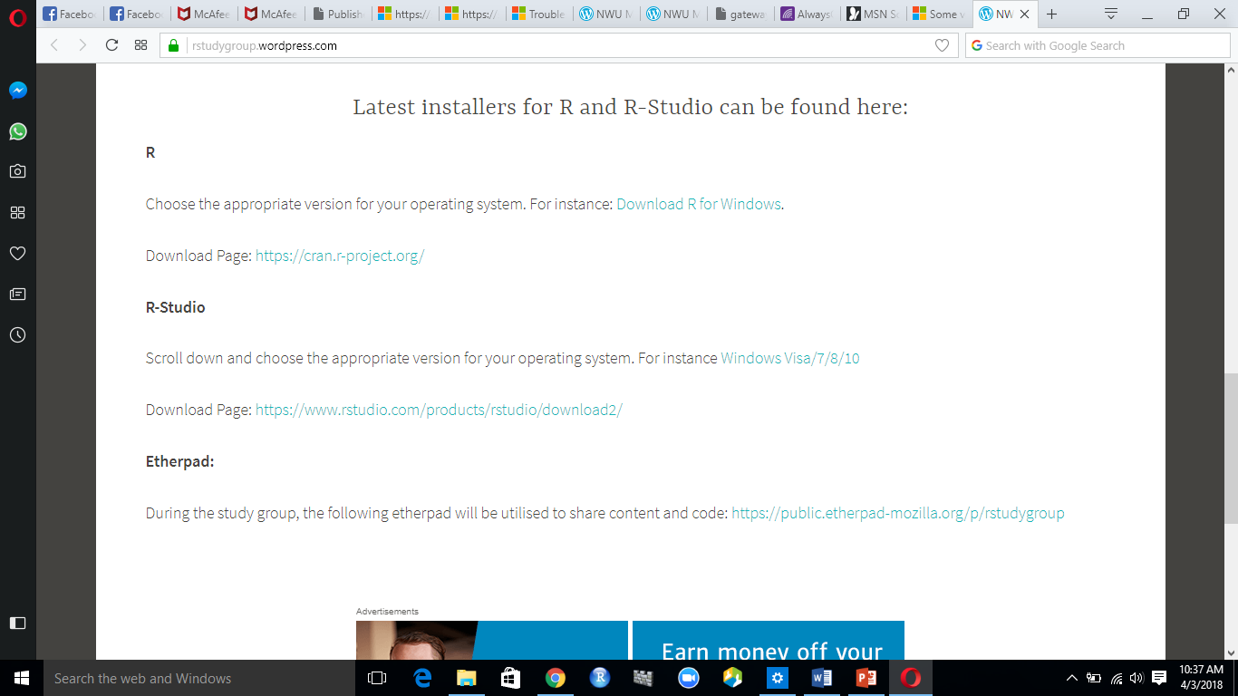

Slide 12
Adopt a Code of Conduct
The carpentries have a code of conduct, so with R study group, there was no trouble about adopting or using a CoC , since it looks like the extension of the workshop.
Therefore, the Galaxy group should also have a CoC to guide the different groups of people coming together, if there is no CoC, then others can be adopted like that of The Carpentries, R-ladies global, Mozzilla study group etc.
This code of conduct can also be a link in the website
It helps to guide our interaction and help us to be sensitive towards one another

Slide 13
Connect with communication avenues
Find out about any avenue or channel through which communication can be sent to advertise the study group e.g graduate managers, IT helpdesk
You can also make use of the attendance generated in the course of the workshop and send bulk mails to all participant in your Dept, group or university as the case may be
Insert the date, time and venue of the first meeting
Be sure to keep the time smart especially if its working hours so participants are not under pressure to quickly return back to work
Be sensitive and give room to allow them to ask for more, that will determine the duration of the next meeting

Slide 14
Preparation for your first meeting
Make sure you followed up with the venue and it is not booked again by another group
In the venue, make sure the seats would cater for the intended number of participants, you can have a few extra seats because some friends might want to come with others
Seating arrangement should be informal with tables available
Also make sure wifi is functional in that venue or other forms of connectivity such as LAN and the cables are available.
Be sure electrical fittings also work well, you can go with a few plugs just to be safe
Be there some minutes to the group meeting

Slide 15
During the meeting
Remember this not the workshop
Help everyone to interact and chat together
Encourage them to talk about frustrations about their work and let them know that is why the study group is available to tackle such
If possible, there could be biscuits, coffee, tea, water etc.
You can start off by going through the lessons learnt during the workshop taking cognizance of the areas needing attention by individuals and asking for help from one another
Be ready to ask for help from participants on their availability to join in organizing subsequent meetings and also “teaching” based on the aspect they understood well.
They could also bring new knowledge or new tools that could enhance the groups productivity

Slide 16
After the first meeting
Be sure to keep to the agreed time or finish a few minutes to the agreed time.
Let them know you would communicate to them as a reminder to the next meeting
Get the emails of those whose emails were not on your list and emails of others that might be interested

Slide 17
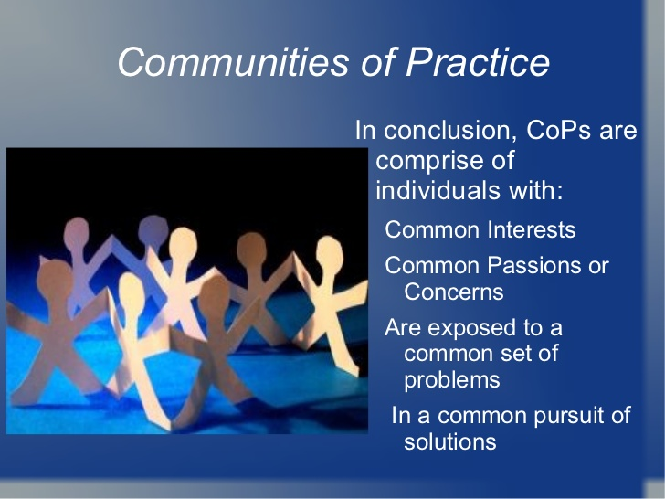
Conclusion
Quality of knowledge is enhanced
Research is open
Continuous learning is supported

Slide 18




ACKNOWLEDGEMENT

Slide 19
THANK YOU FOR LISTENING

Slide 20
References
Olivier Serrat (2008) Building Communities of Practice , Knowledge
Solutions, pp 1-6
Thomas Robb (2018) Communities of Practice
https://clarustechnology.com/2016/03/01/communities-of-practice-2/
Allison Pollard and Ty Crockett (2014) Creating agile communities of practice. Assessed March 2018 https://www.slideshare.net/allisonpollard10/creating-agile-communities-of-practice

