Slide 1

Desired and sustainable livestock systems for food security: a community visioning approach
Leon Gwaka,
Bill Tucker and Julian May

Slide 2


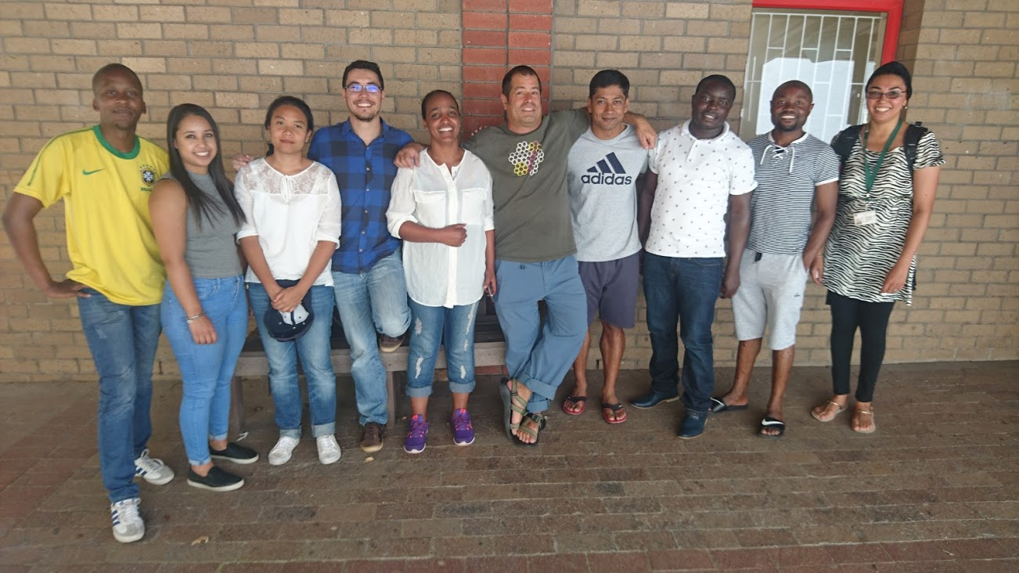
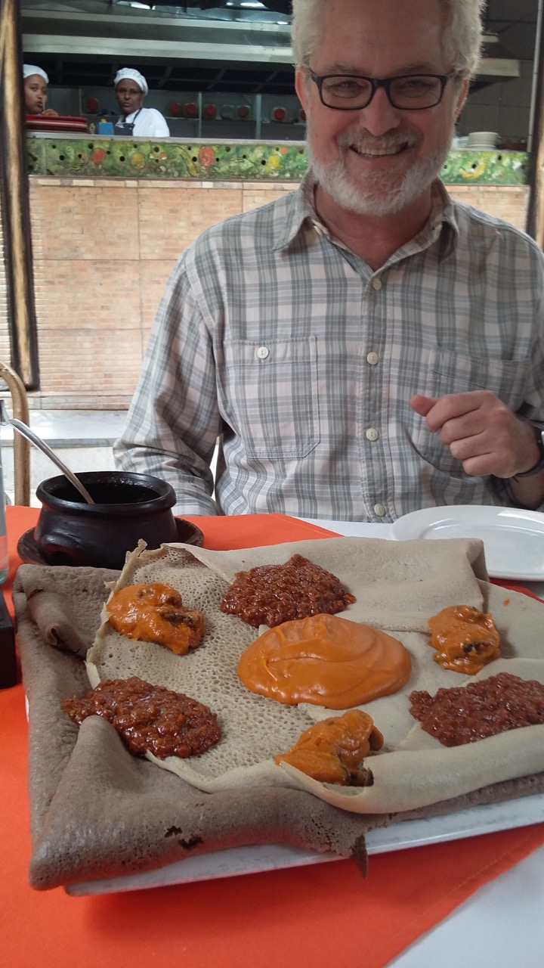

Slide 3
9 billion people in 2050
Fragile food systems
Food insecurity

Slide 4
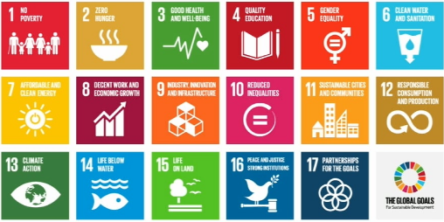
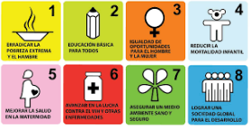
We need alternative bottom-up interventions;
not same old, same old . . .

Slide 5
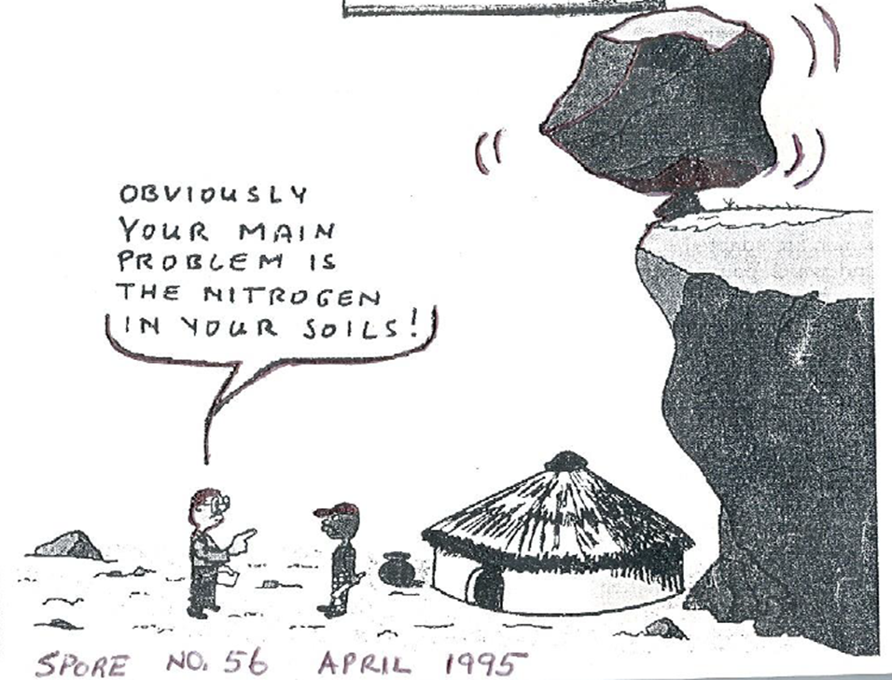
How much voice of communities
do we really hear?
Problem identification
Solution development
Decision-making

Slide 6
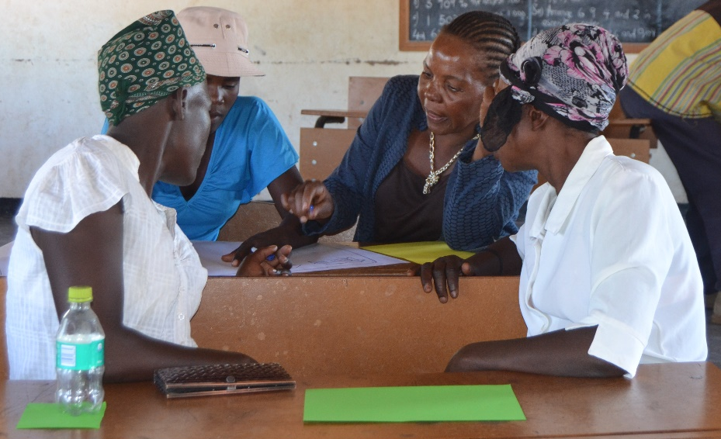
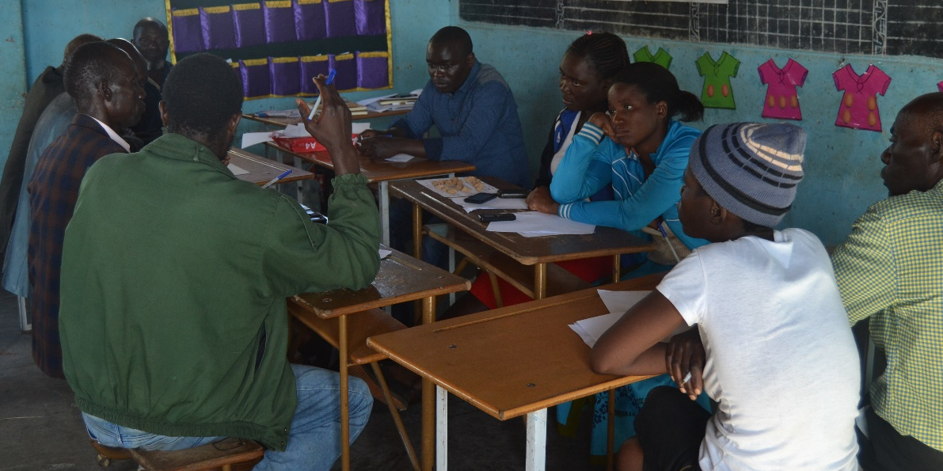
Community visioning
Participatory process of creating a common vision of a desired future food system and strategies to achieve it
Beitbridge District – Zimbabwe

Slide 7
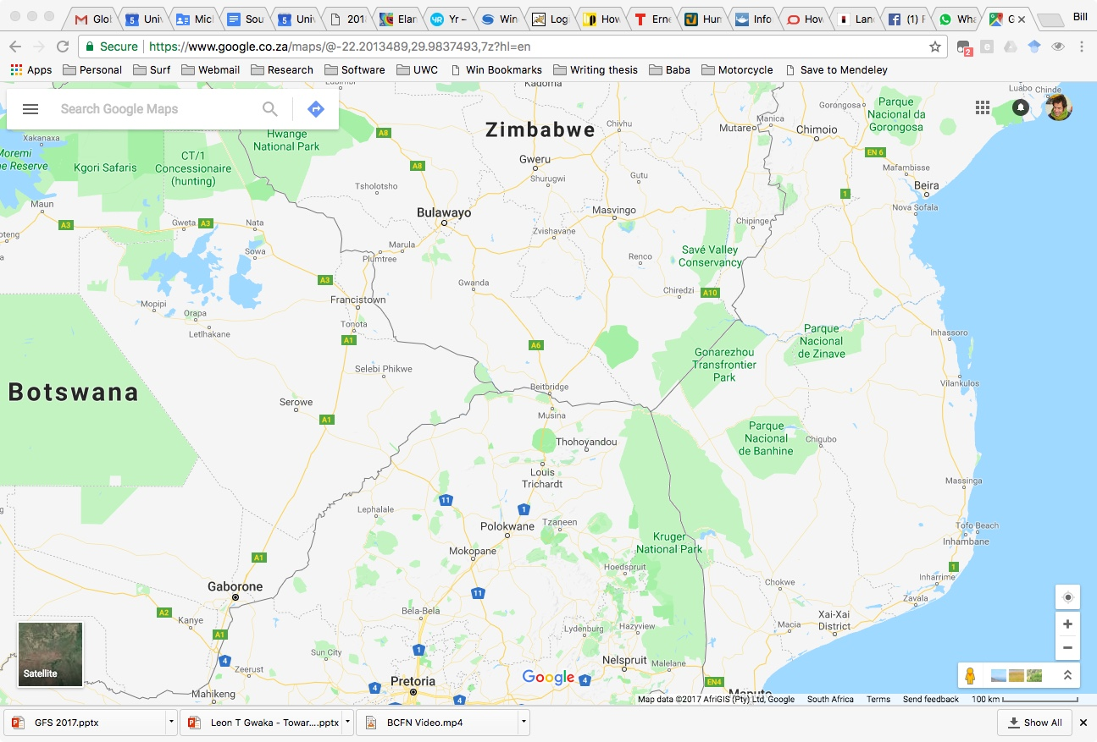
Data from four villages in the Beitbridge area

Slide 8
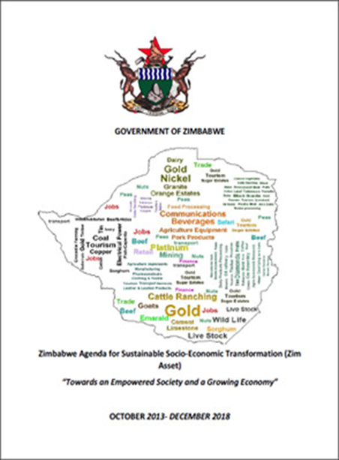
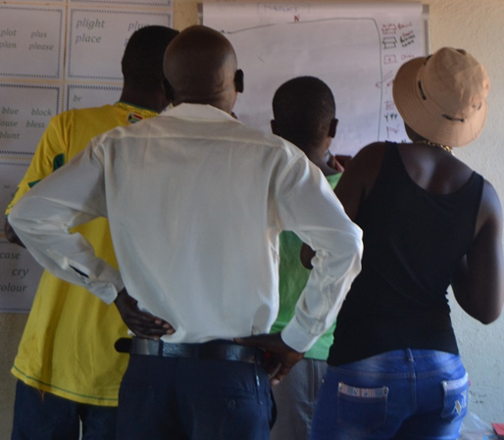
Research activities
Identify & Invite
participants
20%
Engage participants
45%
Reflect & articulate vision
35%
“If you want to go fast, go alone. If you want to go far, go together.”
- African Proverb, or ubuntu

Slide 9
Community development
Dependence
Independence
Interdependence
Kaplan, A. (1996). The Development Practitioners’ Handbook. London: Pluto Press.

Slide 10

Theory of ICT Amplification
What people are already doing
ICT amplifies that
So that they can do it better
Toyama, K. (2015). Geek heresy: Rescuing social change from the cult of technology. PublicAffairs.

Slide 11
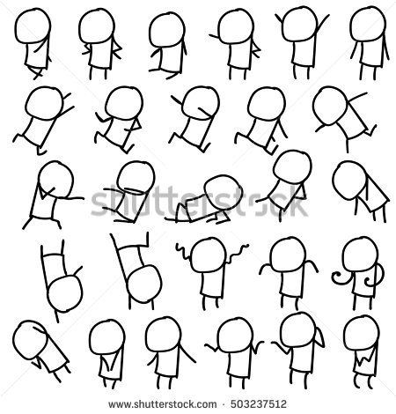
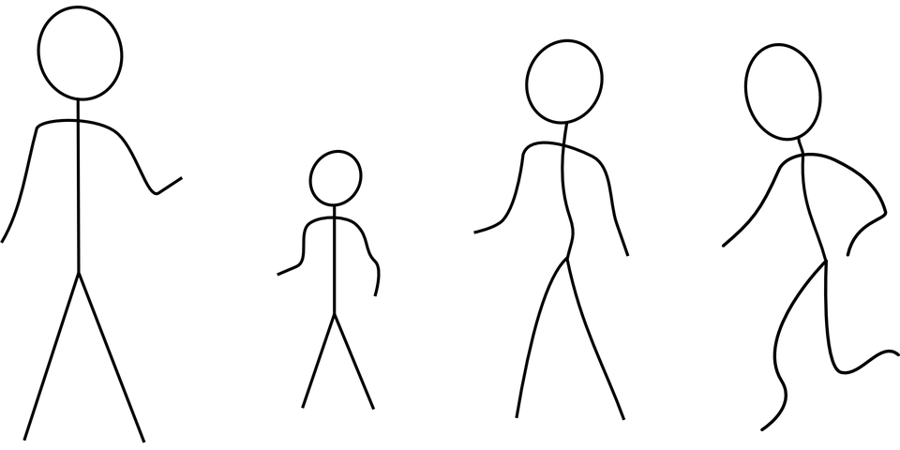
Positive Deviance
Local champions
Social impact
Pascale, R. T., Sternin, J., & Sternin, M. (2010). The Power of Positive Deviance: How Unlikely Innovators Solve the World’s Toughest Problems, Volume 1. Harvard Business Press.

Slide 12
Putting it all together …
Local champions
ICT
Social impact
Tucker, W. D. (2017). Amplifying Positive Deviance with ICT. In J. Choudrie (Ed.), Information and Communication Technologies for Development (ICT4D 2017, IFIP AICT 504) (pp. 206–217). Springer.

Slide 13
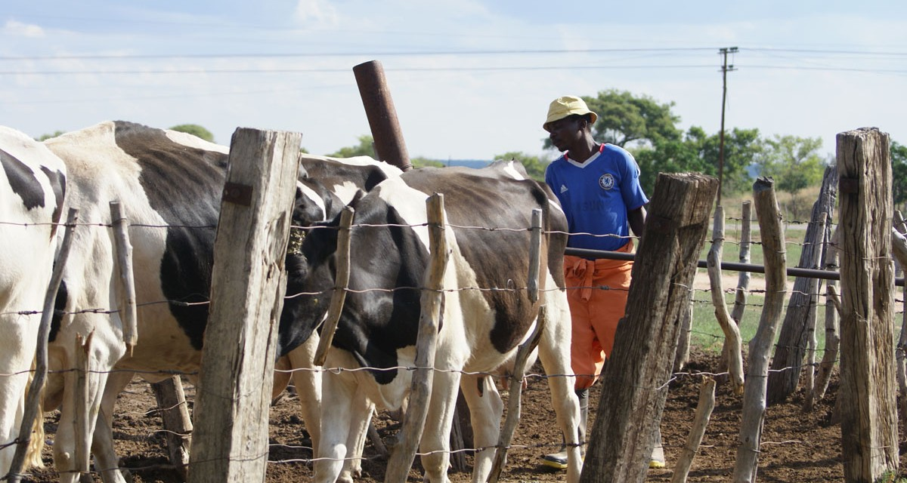
for food security
Community visioning
ICT
Food security in light of climate change

Slide 14
Overarching themes
Technical
Social
Economic
Legal
Environment/ecosystem !!!
Rey-Moreno, C. (2015). Community telco: An acceptable solution for providing affordable communications in rural areas of South Africa. Madrid: Ommpress Ingenieria.
bridges.org. (2004). Real Access / Real Impact criteria. Retrieved from www.bridges.org

Slide 15
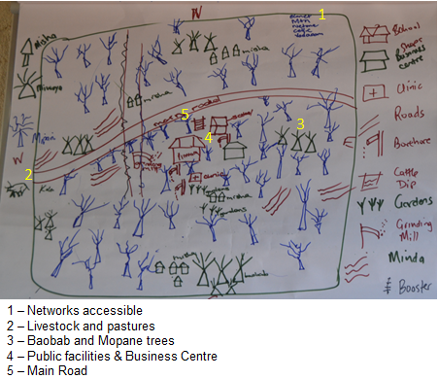
Community assets
Kleine, D. (2010). ICT4WHAT?—Using the choice framework to operationalise the capability approach to development. Journal of International Development, 22(5), 674–692.

Slide 16
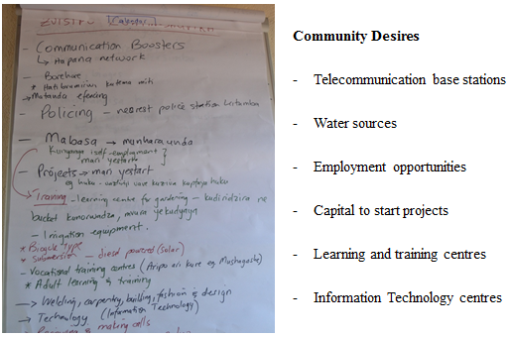

Slide 17
Food security via mutual community development
Dependence
Independence
Interdependence
Asset model vs deficit model
Bottom-up and inclusive → action research
Mixed methods; triangulated
Transferability not replicability

Slide 18






Walking forward together
Leon Gwaka, Institute for Social Development
William D. Tucker (Bill), Computer Science
Julian May, DST CoE in Food Security
Funders
Partners

